Slide 1
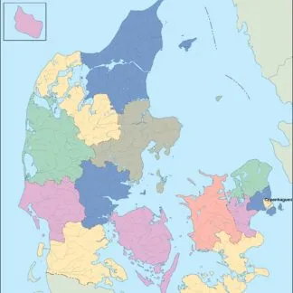
Greenhouse Gases in Denmark
Main Goal:
Since Denmark aims at reducing emissions by 2030 and becoming climate neutral by 2050, the main goal was to look at the fluctuations of greenhouse gas emissions in Denmark (CO2, methane, nitrous oxide) during the last decades, to show the dynamics and to evaluate the impact on the global emissions’ level in order to have a better understanding of whether the country's efforts in fighting climate change are effective
Research Questions:
Evaluating the dynamics of CO2 emissions in Denmark
Evaluating levels of annual emissions for methane, nitrous oxide, greenhouse gases in total: how each gas type affects temperature changes?
Comparing Denmark with other Nordic countries (positive and negative indicators)
Comparing Denmark with several world countries with similar population
Identifying Denmark’s industries with the greatest impact on climate change and taking a look at the prediction for greenhouse gases until 2030

Slide 2
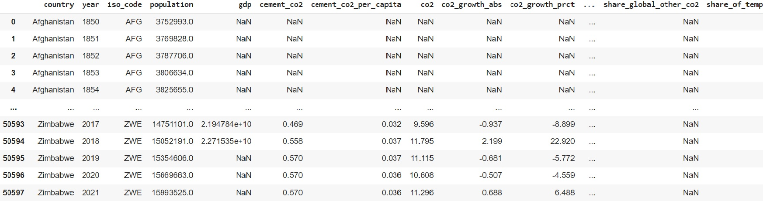
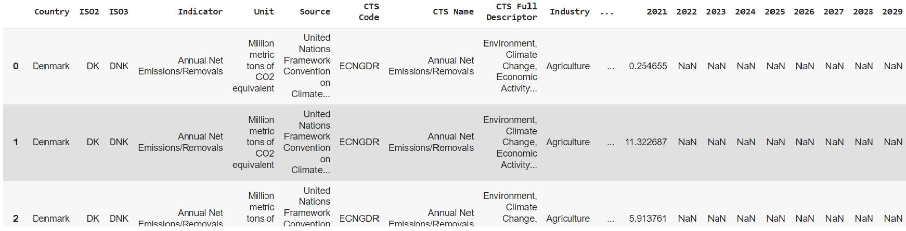
DATASETS:
1. Our World in Data CO₂ and Greenhouse Gas Emissions
CO₂ and Greenhouse Gas Emissions - Our World in Data
2. Denmark Climate Change Indicators – National Greenhouse Gas Emissions Inventories
National Greenhouse Gas Emissions Inventories and Implied National Mitigation (Nationally Determined Contributions) Targets | National Greenhouse Gas Emissions Inventories and Implied National Mitigation (Nationally Determined Contributions) Targets | Climate Change Indicators Dashboard (imf.org)
PERIOD:
Emissions for Denmark and Nordic countries: 2000-2019/2020
Countries with Similar Population Rate: 2010-2020

Slide 3
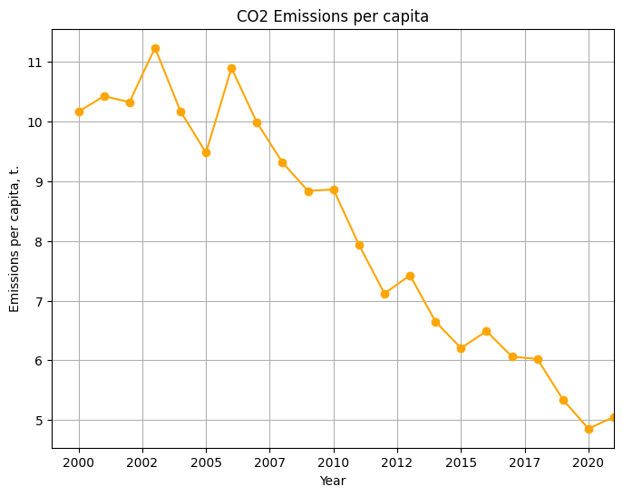
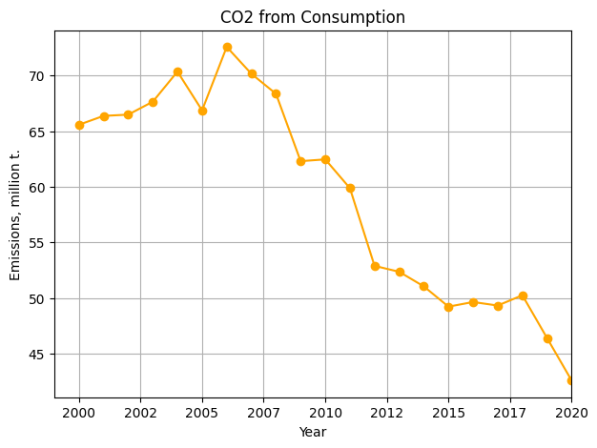
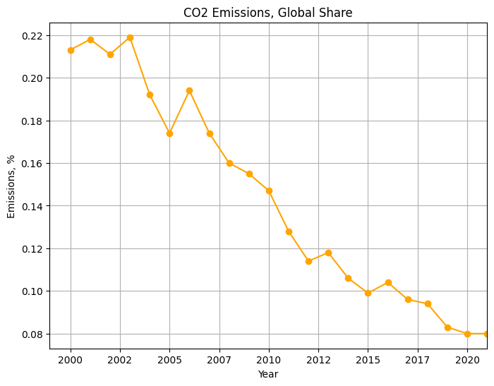
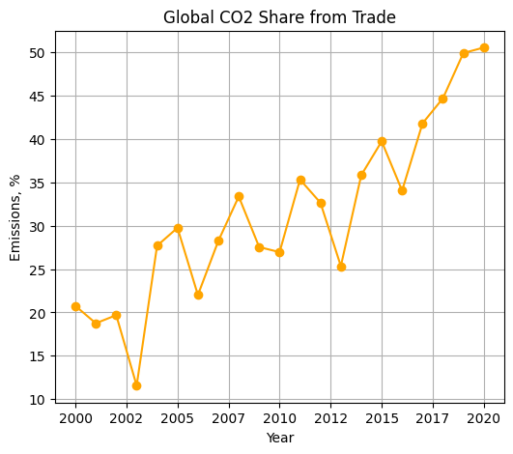
CO2 Emissions in Denmark
Almost all indicators are declining
Main sources of CO2 in Denmark:
combustion of fossil fuels for electricity, heating, transportation, industrial processes
production and processing of materials
energy use in buildings
Associated with the production and transportation of goods throughout their entire life cycle
Represents the carbon footprint of the products we consume (import and export)

Slide 4
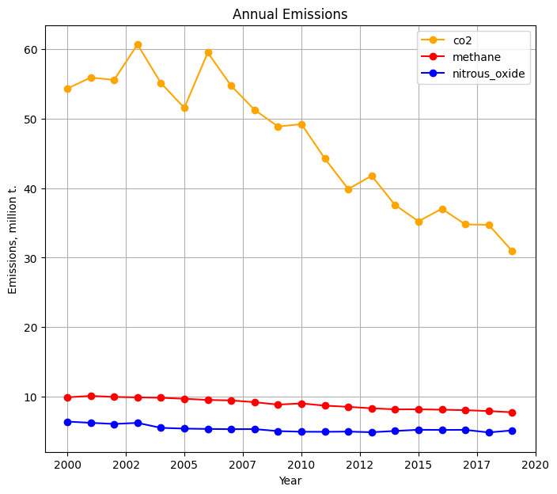
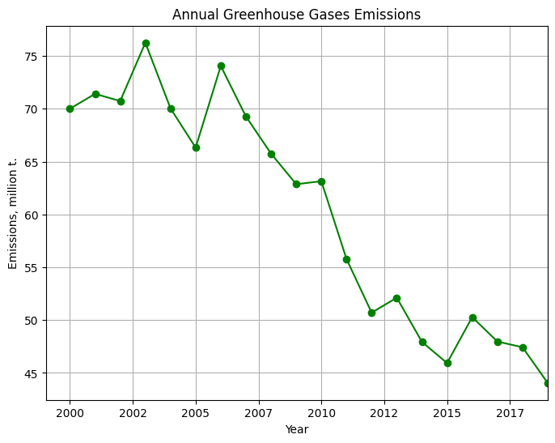
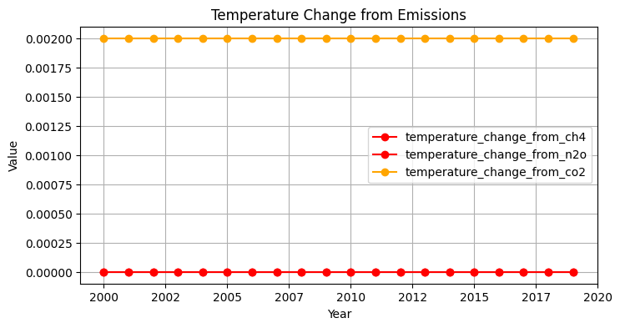
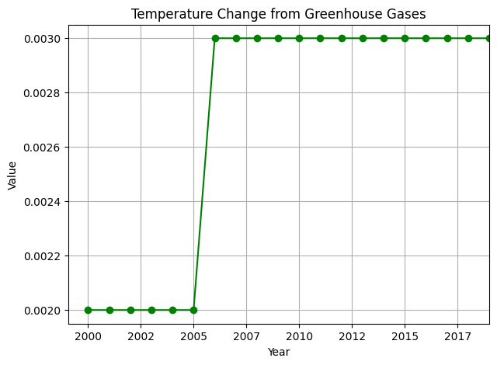
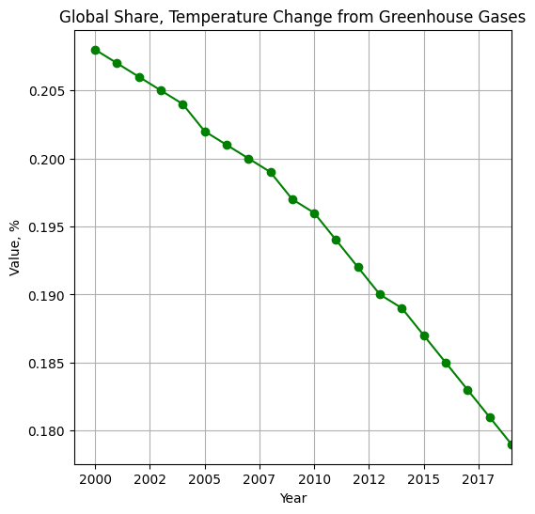
Total Annual values
Main sources of Methane (CH4) in Denmark:
agricultural activities
waste management
energy production, extraction, production, and distribution of natural gas
Main sources of Nitrous Oxide (N2O) in Denmark:
use of synthetic and organic fertilizers, crop residues
industrial processes
Temperature Change

Slide 5
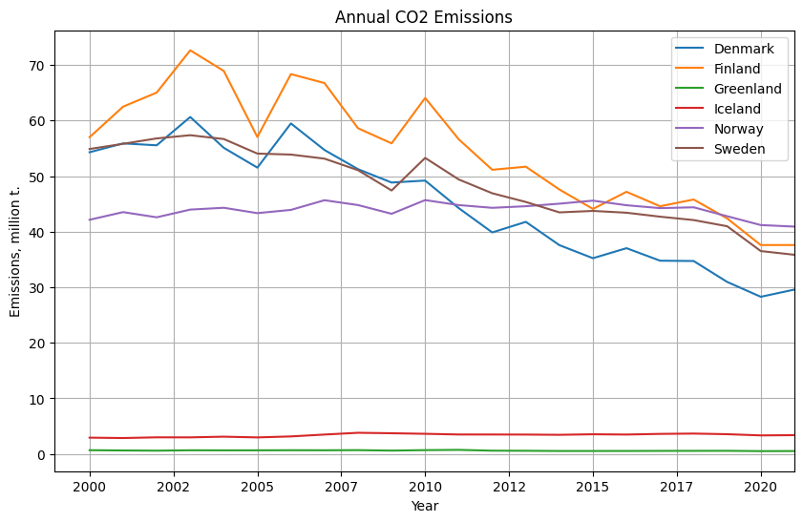
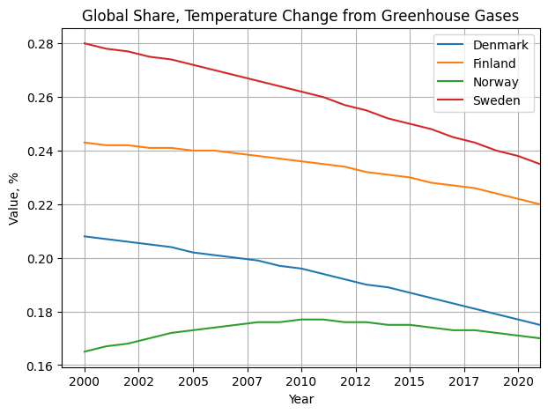
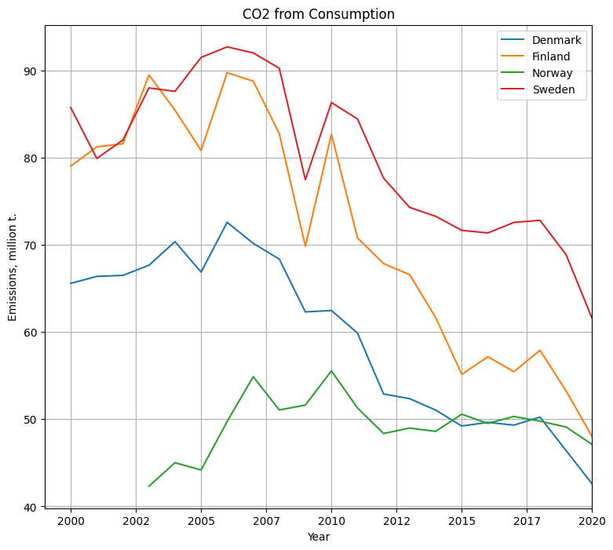
Comparison with Nordic Countries Positive Indicators
Denmark makes a good progress in stable reduction of annual CO2 emissions, including consumption-related CO2, and has a relatively low share in GHG-influenced temperature change

Slide 6
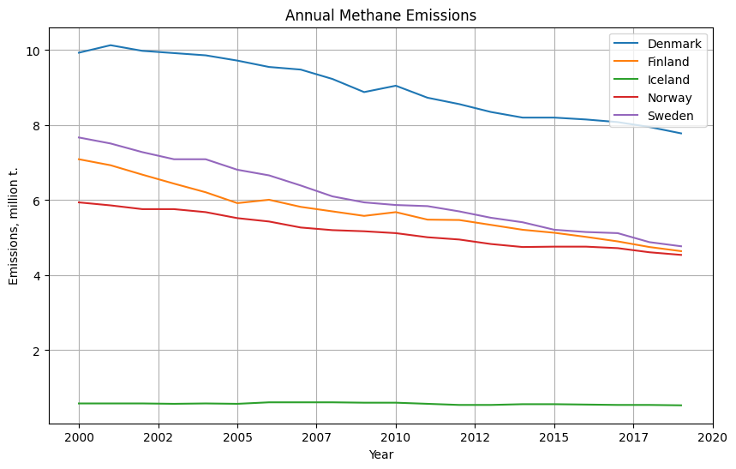
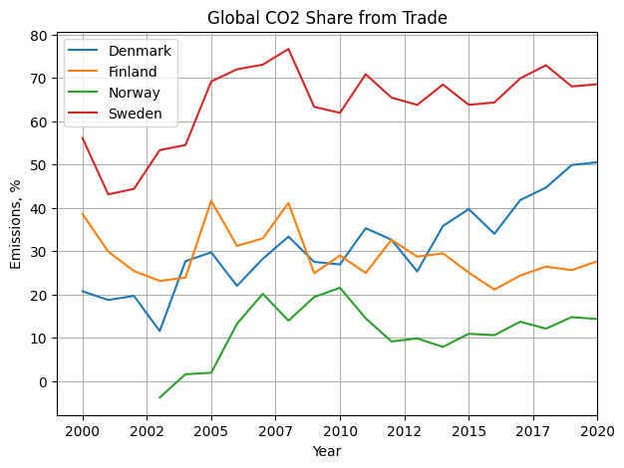
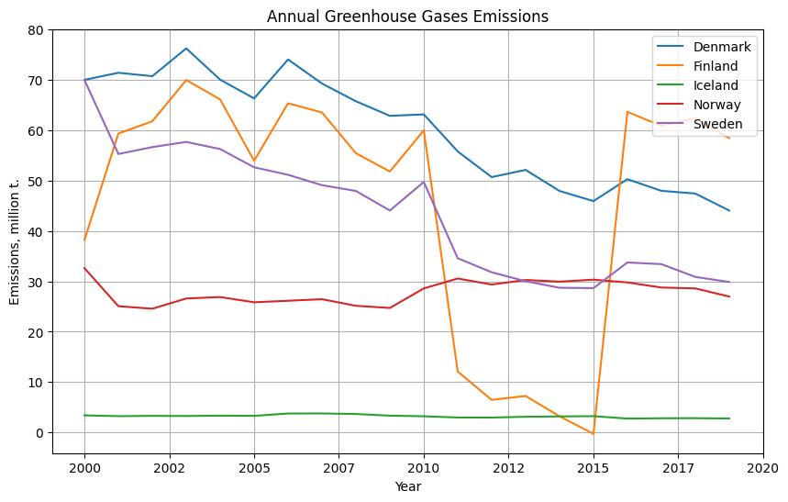
Comparison with Nordic Countries negative Indicators
In comparison with its neighbors, Denmark still has a relatively high annual volume of methane emissions, greenhouse gas emissions, as well as global CO2 share from trading goods, even though it benefits from the export revenue and the world may benefit from Danish technologies (for example, renewable energy)

Slide 7
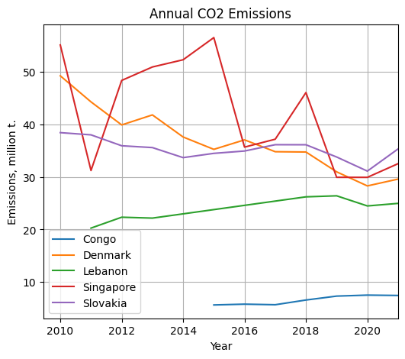
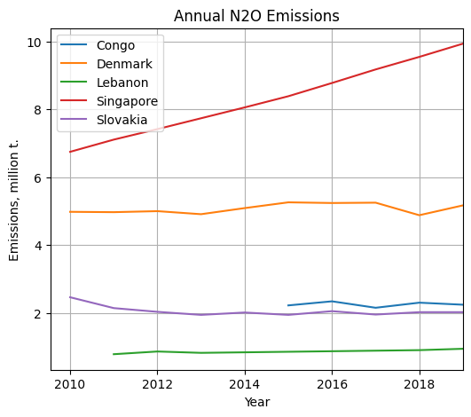
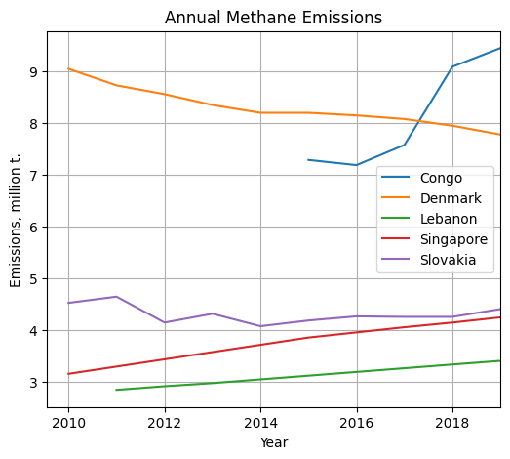
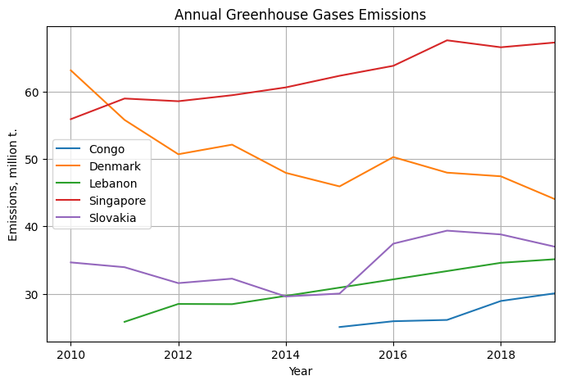
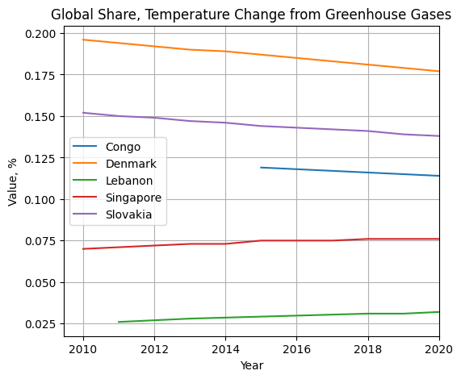
Comparison with countries with similar population
In comparison with the sample of world countries with similar population, Denmark has a high annual volume of methane emissions, relatively high annual greenhouse gas emissions, as well as global share for temperature change
Nevertheless, we can see a stable decline in the indicators

Slide 8
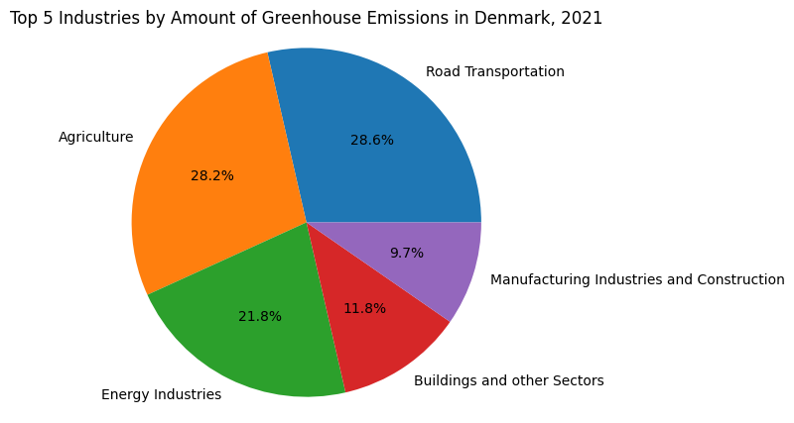
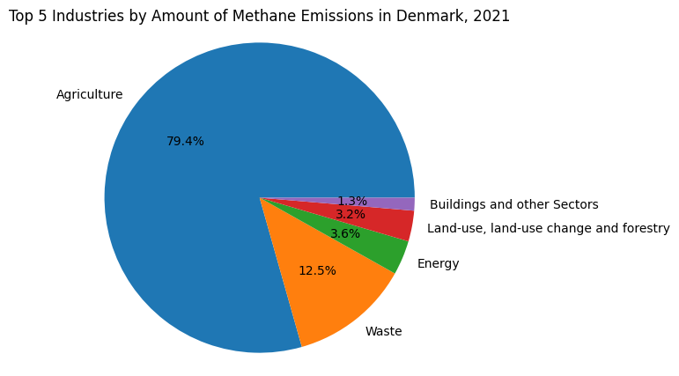
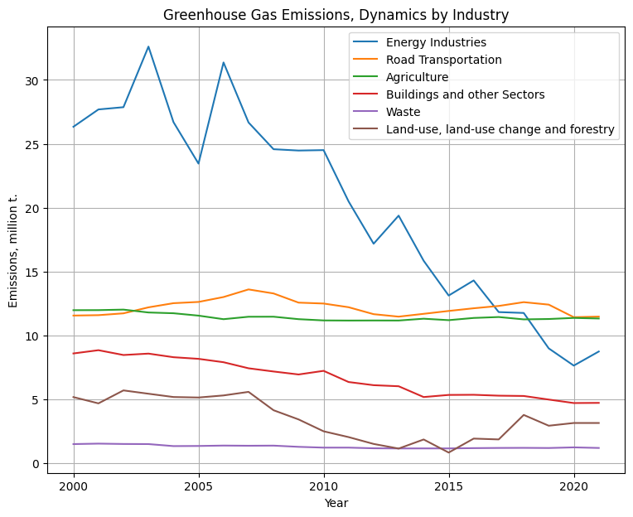
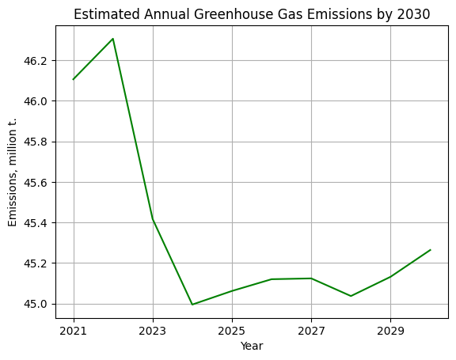
Emissions by Industry and total Emissions by 2030
Methane:
Agriculture
Waste (Organic waste, inefficiencies in waste management practices)
Greenhouse Gas:
Road Transportation (use of fossil-fueled, freight transport)
Agriculture (livestock sector, fertilizer use, land-use change, etc.)
Energy sector (oil and gas extraction, coal mining, refining and processing of fossil fuels, and electricity generation)

Slide 9
Conclusion
Through the last decades, Denmark has made and is making significant progress in reducing greenhouse gas emissions.
Nevertheless, there is still room for improvement and future work.
Global CO2 share from trade:
The country exports and imports a significant amount of goods and services, including manufactured products, which results in the carbon emissions associated with their production. This inflates Denmark's CO2 emissions from trade.
Measures that could remedy the situation include: encouraging more sustainable production methods, promoting resource efficiency, informing consumers about the environmental impact of their purchases, stimulating buying local.
Focus on industries:
Road Transportation (reducing usage of fossils)
Agriculture (reducing emissions from cattle, reconsider fertilizers, encouraging organic farming and consumption, biogas)
Energy (developing and promoting alternative sources of energy: wind, sun, hydrogen)
Improving Waste management (recycling culture)

